Slide 1
Projecting the Impact of Generic HIV Drugs on 90-90-90
Esteban Burrone
Medicines Patent Pool

Slide 2
contents
Impact in terms of treatment affordability
Impact in making new treatments available faster
Impact in making needed new formulations

Slide 3
Innovation in HIV treatment
HIV treatment has witnessed innovation on a major scale
Over 30 new antiretrovirals (ARVs) developed for the treatment of HIV since 1983
Several “fixed dose combinations” developed that contain 3 or 4 ARVs in one single pill
New medicines under development, including new mechanisms of action, new delivery systems, long acting formulations, implants, monoclonal antibodies, etc.

Slide 4
IMpact in terms of treatment affordability

Slide 5
FUNDING to procure ARVs
Today:
21.7 million people on treatment worldwide of which at least 19 million people in low and middle-income countries (based on UNAIDS data )
At approximately USD 85 per patient per year for 1st line (WHO GPRM; Global Fund) *
Spending on ARVs in LMICs is estimated at approximately USD 2 billion
* Some countries procure at higher prices and 2nd and 3rd line ARVS are more expensive

Slide 6
Funding to procure treatment
Without generic manufacturers (hypothetical):
Scenario 1: at US$ 10,439 per patient per year*
(lowest originator price in year 2000):
we would need US$ 198 billion to procure medicines for the same number of people in LMICs
Scenario 2: at US$ 613 per patient per year*
(lowest originator price in 2017):
we would need US$ 11.6 billion to procure medicines for the same number of people in LMICs
or…
if we only have USD 2 billion we would only be able to procure ARVs for approximately 3.3 million people in LMICs
* MSF, Untangling the Web (2010) and MSF, HIV & Opportunistic Infection Treatment: Spotlight On Access Gaps (2017)

Slide 7
Access oriented licensing to enable generic competition
Many factors contributed to large price reductions for ARVs through generic competition enabling treatment scale up (donor funding, strong activism, development of national programs, political will, patent laws, generic manufacturers’ ability to make quality-assured treatments, etc.)
One key mechanism has been access oriented licensing which has increasingly become the norm in HIV
Access-oriented licences are agreements with the patent holders that allow multiple manufacturers to make generic versions of patented medicines and supply large number of LMICs.

Slide 8





The Medicines Patent Pool: A public health organization engaged in access oriented licensing
PEOPLE NEEDING ACCESS TO MEDICINES IN DEVELOPING COUNTRIES
PATENT HOLDERS
GENERIC MANUFACTURERS
Sub-
Licences
Licences
Medicines
ROYALTIES
The MPP is funded by

Slide 9
MPP LICENCES GEOGRAPHICAL COVERAGE
(based on World bank classifications)
Product(s) Licensed | LIC | LMIC | UMIC | HIC | Undefined | Total
Abacavir (paed.) | 31 | 53 | 31 | 5 | 1 | 121 +
Atazanavir | 31 | 52 | 32 | 3 | 3 | 122 +
Bictegravir | 30 | 48 | 25 | 9 | 4 | 116
Cobicistat | 30 | 48 | 25 | 9 | 4 | 116
Daclatasvir | 31 | 46 | 30 | 2 | 3 | 112 +
Dolutegravir (paed.) | 31 | 53 | 31 | 5 | 1 | 121 +
Dolutegravir | 31 | 53 | 6 | 2 | 0 | 92 +
Elvitegravir | 30 | 42 | 17 | 8 | 3 | 100
Lopinavir/Ritonavir (paed.) | 31 | 50 | 19 | 2 | 0 | 102
Lopinavir/Ritonavir (Africa) | 26 | 17 | 10 | 2 | 2 | 57 +
Raltegravir (paed.) | 31 | 50 | 9 | 2 | 0 | 92
Ravidasvir | 1 | 9 | 9 | - | - | 19 #
Sutezolid (global) | 31 | 53 | 56 | 78 | 0 | 218
TDF | 30 | 48 | 25 | 9 | 4 | 116
TAF | 30 | 48 | 25 | 9 | 4 | 116
+ Additional countries may be able to procure generics # Complements DNDi licence for a total of over 130 countries

Slide 10










partnerships with innovators
Lopinavir
Ritonavir
(seperate licences- adults and paediatrics)
Atazanavir
Daclatasvir (HCV)
Nevirapine (non-assert)
Solid dispersion nanotechnology for HIV
Bictegravir
Cobicistat
Elvitegravir
Emtricitabine
Tenofovir Alafenamide
Tenofovir Disoproxil
Darunavir (peadiatric non-assert)
Raltegravir (peadiatric)
Valganciclovir (pricing agreement)
Abacavir ( paediatric)
Dolutegravir (peadiatric)
Dolutegravir (adults)
Darunavir related
Sutezolid (TB)
Ravidasvir (HCV)

Slide 11
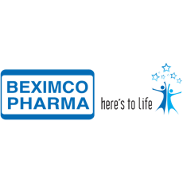


















Generic partners

Slide 12
Impact on 90-90-90
More affordable treatments contribute to the second 90, enabling more people to access treatment with available resources

Slide 13
Impact in making new treatments accessible faster in LMICs

Slide 14
IN THE PAST LONG DELAYS FOR UPTAKE OF NEW
MEDICINES IN LOW AND MIDDLE INCOME COUNTRIES
The Case of Tenofovir (TDF)
Volumes
10-11 Years from Approval to Scale-up
Approval of Tenofovir in US
Scale-up of Tenofovir in Low and Middle Income Countries
Source: GF PPM/PQR data. 2014 for part year;
Notes:
This slide, which I have adapted from the Global Fund shows the transition and uptake of TDF. It took approximately 11 years to see uptake take off for tenofovir in low and middle income countries, following the introduction of the drug in the United States.
There are a large number of reasons for that across the whole chain of events that need to happen to see a new HIV medicine accessed by those who may need the medicine. These relate to changes in treatment guidelines and protocols, to development of affordable versions, to introductions of suitable fixed dose combinations, to pricing, to inclusion in procurement lists or essential medicines lists, regulatory approval and in-country registration, to treatment advocacy and understanding on how to use the new drug, procurement and supply chain issues, understanding on wheTher drug appropriate for different age groups or different populations (e.g. people with TB, pregnant women), etc.
11 years. This would mean that for a new drug like DTG (approved in August 2013) we would need to wait until 2024 before we started seeing uptake in LMICs
But let’s zoom in on one of these, which is the availability of affordable versions of the medicine for use in LMICs

Slide 15
The case of dolutegravir (DTG)
4 years from originator approval to availability from multiple suppliers in a new fixed dose combination (“TLD”) at affordable prices
August 2013: DTG approved by US FDA
June 2016 WHO guidelines recommend DTG in 1st line
Sept 2017
Price of USD 75 announced for DTG combination
2013
2014
2015
2016
2017
April 2014: MPP license with ViiV Healthcare
November 2016:
First MPP licensees filed for WHO Prequalification
August 2017: First approval of new combination (TLD) from MPP licensee

Slide 16
Impact in making needed new formulations

Slide 17
Adult fixed dose combinations
Case of Tenofovir/lamivudine/dolutegravir (TLD)
Dolutegravir has higher barrier to resistance than current first line with efavirenz (SPRING trial)
It is better tolerated, with fewer treatment discontinuations
TDF: enables treatment for hepatitis B in co-infected people and no need for HLA-B*5701 screening
Potential for lower price than efavirenz combination
Caution regarding potential safety signal for women with HIV at time of conception (issue to be further discussed at IAS)
http://www.who.int/medicines/publications/drugalerts/Statement_on_DTG_18May_2018final.pdf

Slide 18
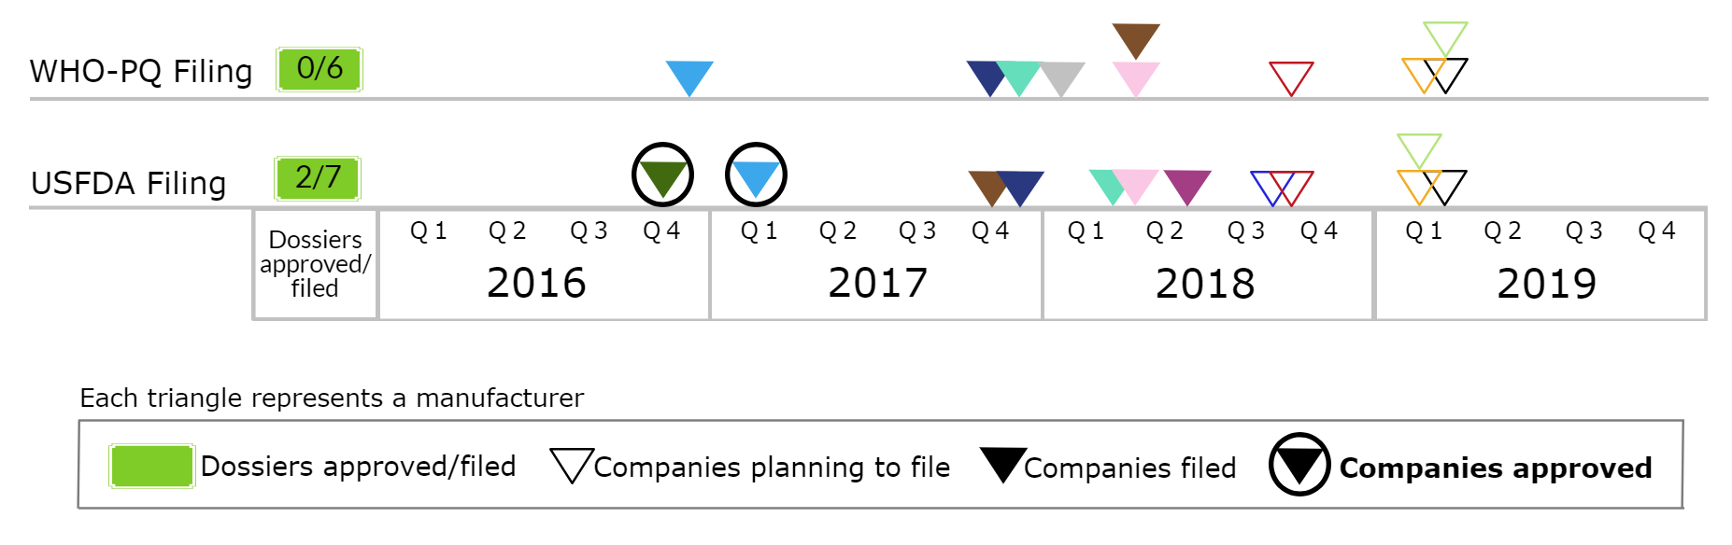
TDF/3TC/DTG
(tenofovir disoproxil/lamivudine/dolutegravir)
13 MPP licensees are currently developing TDF/3TC/DTG, of which:
  6 have filed with WHO-PQ
  7 have filed with USFDA; of which two have received approvals
4 companies have received approval by the WHO/Global Fund Expert Review Panel
In all, 2 generic versions of TLD are already in the market and an additional 4 are expected to be launched soon

Slide 19
TDF/3TC/DTG: Country-wise Filing Status
Approved (6) (19.4% PLHIV in LMICs)
Botswana
Côte d'Ivoire
India
Kenya
Malawi
Uzbekistan
Filed (25) (69.2% PLHIV in LMICs)
Benin | Ghana | South Africa
Burkina Faso | Madagascar | Tanzania
Burundi | Mali | Uganda
Cameroon | Mozambique | Ukraine
Congo | Namibia | Vietnam
DR Congo | Niger | Zambia
El Salvador | Nigeria | Zimbabwe
Ethiopia | Rwanda
Gabon | Senegal
Generic TLD has been filed in 31 countries, of which approval is received from 6
Another 25 filings are planned for 2018

Slide 20
Paediatric formulations
LPV/r
(sprinkles in sachet or minitabs in capsule)
Three companies working on this product:
  One company has received USFDA approval
  Another has filed with WHO-PQ and USFDA in Q1-18
  The third plans to file with USFDA and WHO-PQ in Q3-19
LPV/r/ABC/3TC
(sprinkles in sachet or minitabs in capsule)
Three companies working on this product:
  One plans to file with USFDA and WHO-PQ in Dec-18
  Another plans to file with USFDA and WHO-PQ in 2019
  Another developing, filing status and plans unknown
ABC/3TC/EFV
Three companies working on the product
  Filing plans in 2019
ABC/3TC/DTG
Multiple companies interested in development, awaiting WHO recommendation on dosage

Slide 21
Impact on 90-90-90
Faster access to new optimized ARVs and development of needed adult and paediatric formulations contributes to the third 90, through access to optimized formulations that are better tolerated, lower treatment discontinuations, higher resistance barrier

Slide 22
The MPP’s HIV, TB and hepatitis C activities are fully funded by:

Slide 23
Thank you
www.medicinespatentpool.org
www.medspal.org
@MedsPatentPool

